Slide 1
Image Compression with JPEG Encoding Scheme
Image compression is the method of data compression on digital images. The main objective in the image compression is:
(a)Store data in an efficient form
(b)Transmit data in an efficient form
Image Compression can be lossy or lossless.
JPEG stands for Joint photographic experts group. It is the first international standard in image compression. It is widely used today. It could be lossy as well as lossless.

Slide 2
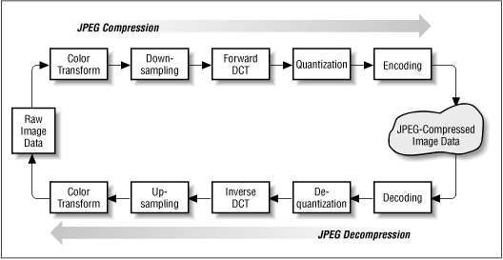
JPEG Image Compression (Encoder)
Fig:JPEG Compression Scheme

Slide 3
JPEG Algorithm
Step 1; Dividing image into 8*8 blocks : Attempting to compress an entire image would not yield optimal results. Therefore, JPEG divides the image into matrices of 8 x 8 pixel blocks. This allows the algorithm to take advantage of the fact that similar colors tend to appear together in small parts of an image.
Step 2; Level Shifting of image blocks : The algorithm subtracts 128 from each byte in the 64-byte block. This changes the scale of the byte values from 0…255 to –128…127. Thus, the average value over a large set of pixels will tend towards zero.
Step 3; DCT Transform of Image blocks : A DCT is applied to each 8x8 block. DCT converts the spatial image representation into a frequency map: the low-order or "DC" term represents the average value in the block, while successive higher-order ("AC") terms represent the strength of more and more rapid changes across the width or height of the block. The highest AC term represents the strength of a cosine wave alternating from maximum to minimum at adjacent pixels.

Slide 4
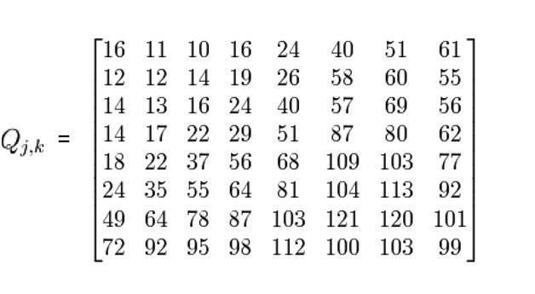
JPEG Algorithm
Step 4; Quantization :To discard an appropriate amount of information, the compressor divides each DCT output value by a "quantization coefficient" and rounds the result to an integer. There is a standard matrix that is used for computing JPEG compression quantization, which is given by a matrix called as Luminance matrix. The equation used to calculate the quantized frequency matrix is fairly simple. The algorithm takes a value from the DCT matrix and divides it by its corresponding value in the quantization matrix (Q).

Slide 5
JPEG Algorithm
Step 5; Entropy Coding : After quantization, the algorithm is left with blocks of 64 values, many of which are zero. The algorithm uses a zigzag ordered encoding, which collects the high frequency quantized values into long strings of zeros. This is called Runlenght Encoding. The 64 quantized transformed coefficients ( Which are now integers) of each data unit are encoded using a combination of RLE and Huffman coding to reduce redundancy. The DC coefficient (u,v)=(0,0) is coded with DPCM encoding and the AC components are coded using RLE and Huffmann encoding.
The JPEG standard offers a separate lossless mode. JPEG lossless is a form of Predictive Lossless Coding using a 2D Differential Pulse Code Modulation (DPCM) scheme. The basic premise is that the value of a pixel is combined with the values of up to three neighboring pixels to form a predictor value.

Slide 6
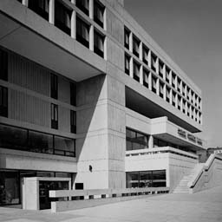

JPEG image compression (Example)
Original Image :
(File Size=17832 bytes)
Compressed Image :
(File Size=11852 bytes)

Slide 7
Conclusion
From looking at the experimental results, there is wiggle room in terms of how they tune the block size and choose the mask they use. Although the standard block size is 8-pixels by 8-pixels, usually the most well-rounded choice,a different block size may be better suited to a particular image. By varying the mask, the image quality and output file size can be changed as well. JPEG image compression is definitely an interesting extension of some of the concepts we learned. We have demonstrated that conversion from a grayscale image to the JPEG encoded image is a fairly simple and straightforward process.

